Slide 1
Rigid Formats Controlled Text Generation
Piji Li Haisong Zhang Xiaojiang Liu Shuming Shi, ACL 2020
Apple
Notes:
ID=d924773e-9a16-4d6d-9803-8cb819e99682 Recipe=text_billboard Type=TextOnly Variant=0 FamilyID=AccentBoxWalbaum_Zero

Slide 2

Contents
Introduction
Task Definition
Framework Description
Experimental Setup
Results and Discussions
Conclusion

Slide 3
Introduction
1

Slide 4
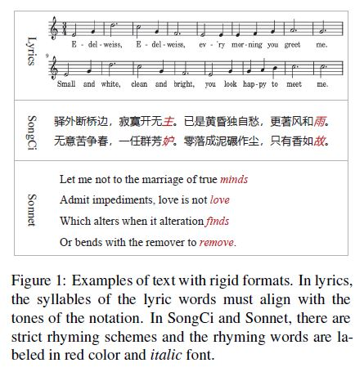
Introduction
Tremendous progress in natural language generation tasks (machine translation, dialogue system, text summarization, story telling, poetry writing, etc)
No constraints on the format and structure (or just let the model capture this feature implicitly during training.)
Question: do model generate satisfying results according to arbitrary new defined formats in this way?

Slide 5
Introduction
The paper focuses on some special text paradigms such as Sonnet (Shakespeare’s Sonnets) and SongCi.
Characteristic of these texts:
rigid formats
rhyming schemes
integrity

Slide 6
Task Definition
2

Slide 7
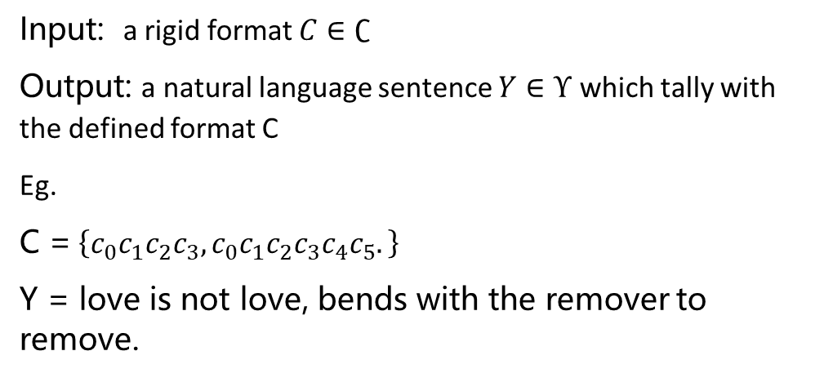
Task Definition
Input: a rigid format $C∈∁$
Output: a natural language sentence $Y∈Υ$ which tally with the defined format C
Eg.
C =$\left\{c_{0}c_{1}c_{2}c_{3}, c_{0}c_{1}c_{2}c_{3}c_{4}c_{5}.\right\}$
Y = love is not love, bends with the remover to remove.
Target: find a mapping function G to conduct the rigid formats controlled text generation:
Y = G(C)

Slide 8
Framework Description
3

Slide 9
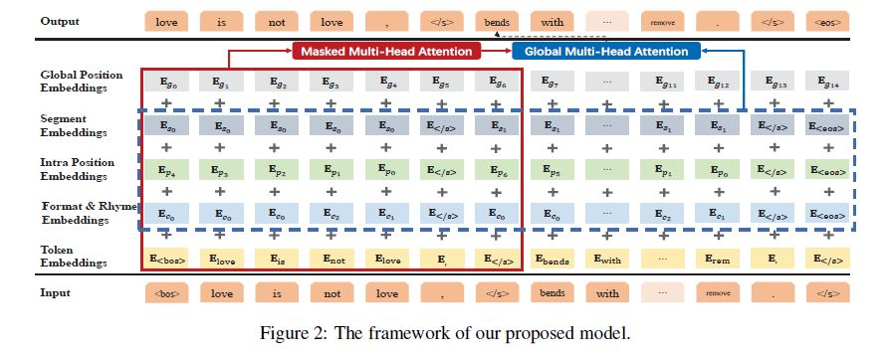
SongNet

Slide 10
Framework Description
Backbone : a Transformer-based auto-regressive language model
The input can be the whole token of samples from SongCi or Sonnet.
Design several sets of indicating symbols to enhance the performance in terms of accuracy on format, rhyme, and sentence integrity

Slide 11
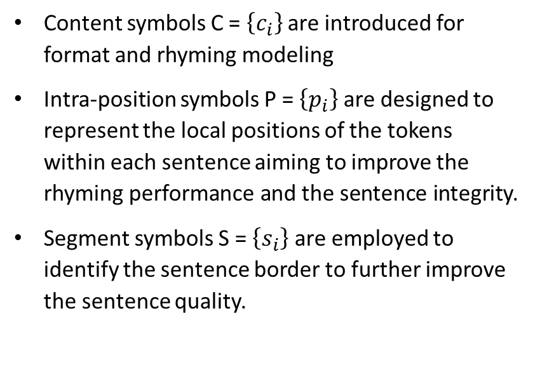
Framework Description
Content symbols C = $\left\{c_{i}\right\}$ are introduced for format and rhyming modeling
Intra-position symbols P = $\left\{p_{i}\right\}$ are designed to represent the local positions of the tokens within each sentence aiming to improve the rhyming performance and the sentence integrity.
Segment symbols S = $\left\{s_{i}\right\}$ are employed to identify the sentence border to further improve the sentence quality.
Attention mechanism is improved to impel the model to capture the future format information such as the sentence ending markers.
Similar to BERT and GPT, pre-training and fine-tuning paradigm is utilized to boost the performance of the original models

Slide 12
Framework Description
Input:
“<bos> love is not love, </s>,
bends with the remover to remove . </s>”
Output: a left-shifting version of the input (tokenized)
“love is not love, </s>
bends with the remover to remove . </s> <eos>
We use the sentence (as shown in Figure 1) “love is not love,
bends with the remover to remove”
extracted from the Shakespeare’s as examples to describe the details of our framework SongNet.

Slide 13
Framework Description
Format and Rhyme Symbols:
C = {c0, c0, c0, c2, c1, </s>
c0, c0, c0, c0, c0, c2, c1, </s>, <eos>}
Intra Position Symbols:
P = {p4, p3, p2, p1, p0, </s>
p6, p5, p4, p3, p2, p1, p0, </s>, <eos>}
We use the sentence (as shown in Figure 1) “love is not love,
bends with the remover to remove”
extracted from the Shakespeare’s as examples to describe the details of our framework SongNet.

Slide 14
Framework Description
Segment Symbols:
S = {s0, s0, s0, s0, s0, </s>
s1, s1, s1, s1, s1, s1, s1, </s>, <eos>}
Global Position Symbols:
P = {g1, g2, g3, g4, g5, g6
g7, g8, g9, g10, g11, g12, g13, g14, g15}
We use the sentence (as shown in Figure 1) “love is not love,
bends with the remover to remove”
extracted from the Shakespeare’s as examples to describe the details of our framework SongNet.

Slide 15
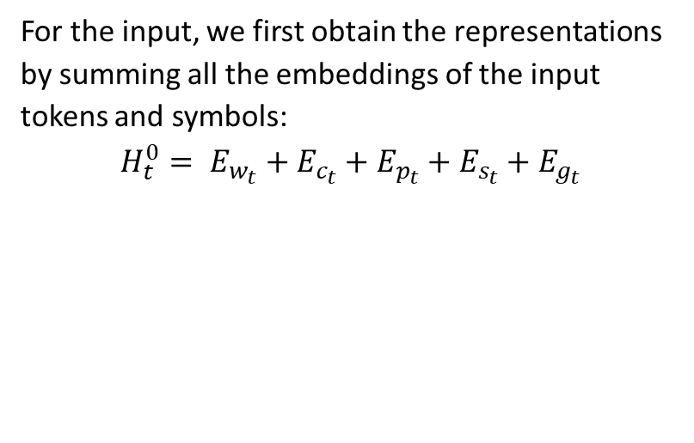
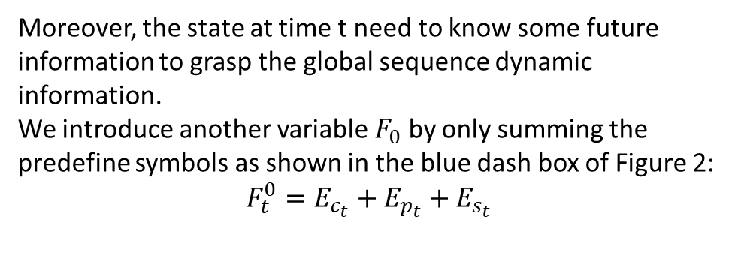
Framework Description
For the input, we first obtain the representations by summing all the embeddings of the input tokens and symbols:
$$H_{t}^{0}= E_{w_{t}}+E_{c_{t}}+E_{p_{t}}+E_{s_{t}}+E_{g_{t}}$$
Moreover, the state at time t need to know some future information to grasp the global sequence dynamic information.
We introduce another variable $F_{0}$ by only summing the predefine symbols as shown in the blue dash box of Figure 2:
$$F_{t}^{0}=E_{c_{t}}+E_{p_{t}}+E_{s_{t}}$$
Two blocks of attention mechanisms are introduced to conduct the feature learning procedure:
Masking multi-head self-attention, and global multi-head attention

Slide 16
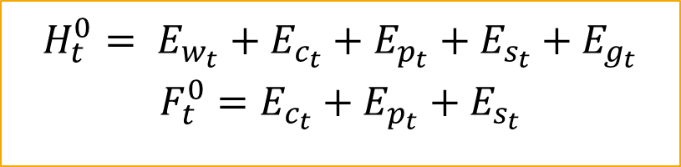
Framework Description
$$H_{t}^{0}= E_{w_{t}}+E_{c_{t}}+E_{p_{t}}+E_{s_{t}}+E_{g_{t}}$$
$$F_{t}^{0}=E_{c_{t}}+E_{p_{t}}+E_{s_{t}}$$

Slide 17
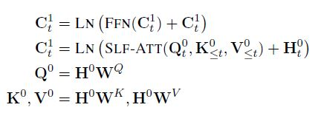
Framework Description
Masking Multi-Head Self-Attention
$$H_{t}^{0}= E_{w_{t}}+E_{c_{t}}+E_{p_{t}}+E_{s_{t}}+E_{g_{t}}$$
$$F_{t}^{0}=E_{c_{t}}+E_{p_{t}}+E_{s_{t}}$$

Slide 18
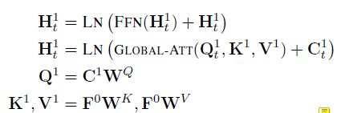
Framework Description
Global Multi-Head Attention
$$H_{t}^{0}= E_{w_{t}}+E_{c_{t}}+E_{p_{t}}+E_{s_{t}}+E_{g_{t}}$$
$$F_{t}^{0}=E_{c_{t}}+E_{p_{t}}+E_{s_{t}}$$

Slide 19
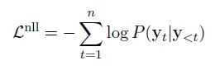
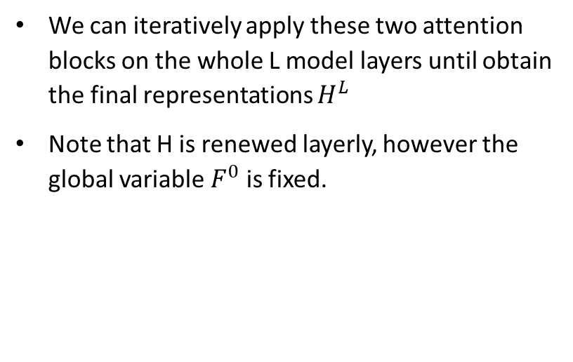
Framework Description
We can iteratively apply these two attention blocks on the whole L model layers until obtain the final representations $H^{L}$
Note that H is renewed layerly, however the global variable $F^{0}$ is fixed.
Finally, the training objective is to minimize the negative log-likelihood over the whole sequence:

Slide 20
Framework Description
We can assign any format and rhyming symbols C to control the generation. Given C, we will obtain P and S automatically.
The model can conduct generation starting from the special token <bos> iteratively until meet the ending marker <eos>.
Beam-search algorithm and truncated top-k sampling method are utilized to conduct the decoding.

Slide 21
Experimental Setup
4

Slide 22
Settings
The number of layers L = 12, and hidden size is 768
12 heads in both the masking multi-head self-attention block and the global attention block
Adam optimization with Noam learning-rate decay strategy and 10,000 warmup steps is employed to conduct the training

Slide 23
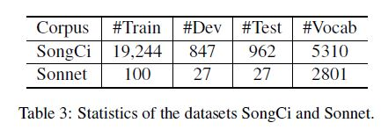
Datasets
We conduct all the experiments on two collected corpus with different literary genres: SongCi and Sonnet, in Chinese and English respectively
We conduct the pre-training procedure on two large scale corpus in the corresponding languages respectively
For Chinese, we collect Chinese Wikipedia (1700M Characters) and a merged Chinese News (9200M Characters) corpus from the Internet
For English, same as BERT, we employ English Wikipedia (2400M words) and BooksCorpus (980M words) to conduct the pre-training

Slide 24
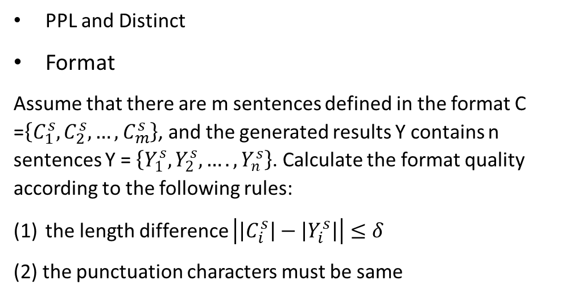
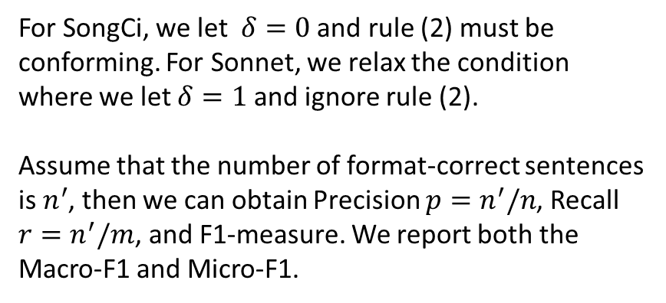
Evaluation Metrics
PPL and Distinct
Format
Assume that there are m sentences defined in the format C =$\left\{C_{1}^{s},C_{2}^{s},…,C_{m}^{s}\right\}$, and the generated results Y contains n sentences Y = $\left\{Y_{1}^{s},Y_{2}^{s}, …., Y_{n}^{s}\right\}$. Calculate the format quality according to the following rules:
the length difference $\left|\left|C_{i}^{s}\right|−\left|Y_{i}^{s}\right|\right|≤δ$
(2) the punctuation characters must be same
For SongCi, we let $δ=0$ and rule (2) must be conforming. For Sonnet, we relax the condition where we let $δ=1$ and ignore rule (2).
Assume that the number of format-correct sentences is $n^{′}$, then we can obtain Precision $p=n^{′}/n$, Recall $r=n^{′}/m$, and F1-measure. We report both the Macro-F1 and Micro-F1.

Slide 25
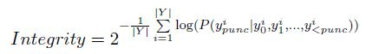
Evaluation Metrics
Rhyme
For SongCi, usually, there is only one group of rhyming words in one sample. For Shakespeare’s Sonnets corpus, the rhyming rule is clear “ABAB CDCD EFEF GG” and there are 7 groups of rhyming tokens.
We report the Macro-F1 and Micro-F1
Integrity
For example, the integrity of “love is not love . </s>” is
much better than “love is not the . </s>”
we calculate the prediction probability of the punctuation characters before </s> given the prefix tokens:

Slide 26
Evaluation Metrics
Human Evaluation
Relevance, Fluency, and Style

Slide 27
Comparison Methods
S2S: Sequence-to-sequence framework with attention mechanism
GPT2
SongNet (our proposed framework)
We also conduct ablation analysis to verify the performance of the defined symbols as well as the variants of model structures:
SongNet (only pre-tuning): Without the finetuning stage.
SongNet (only fine-tuning): Without the pretraining stage.
SongNet-GRU: Employ GRU to replace Transformer as the core structure.
SongNet w/o C: Remove the format and rhyme symbols C.
SongNet w/o P: Remove the intra-position symbols P.
SongNet w/o S: Remove the sentence segment symbols S.
SongNet w/ inverse-P: Arrange the intra-position indices in ascending order instead of the descending order.

Slide 28
Results and Discussion
5

Slide 29
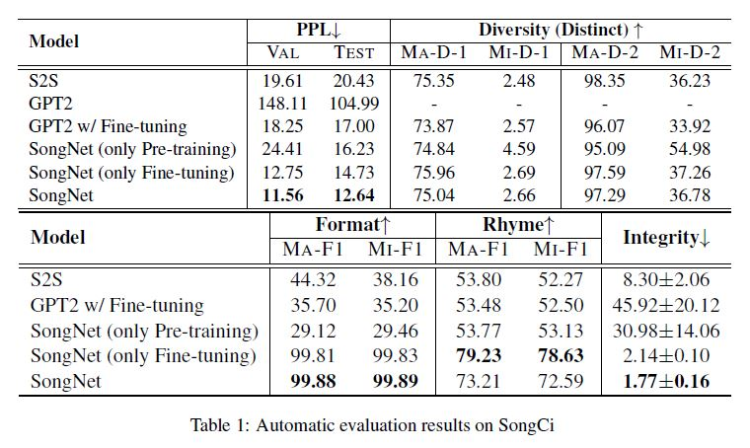

Slide 30
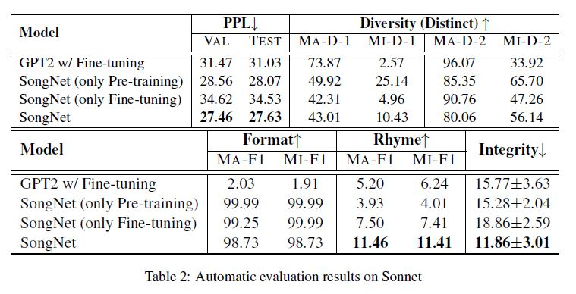

Slide 31
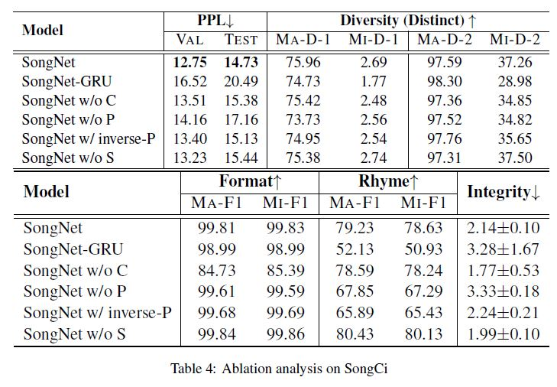

Slide 32
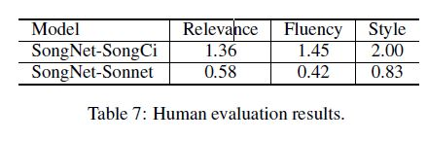

Slide 33
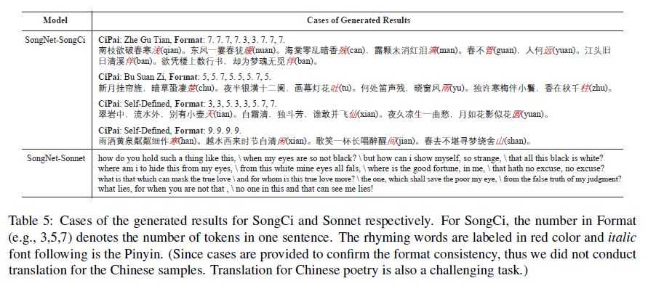

Slide 34
Conclusion
6

Slide 35
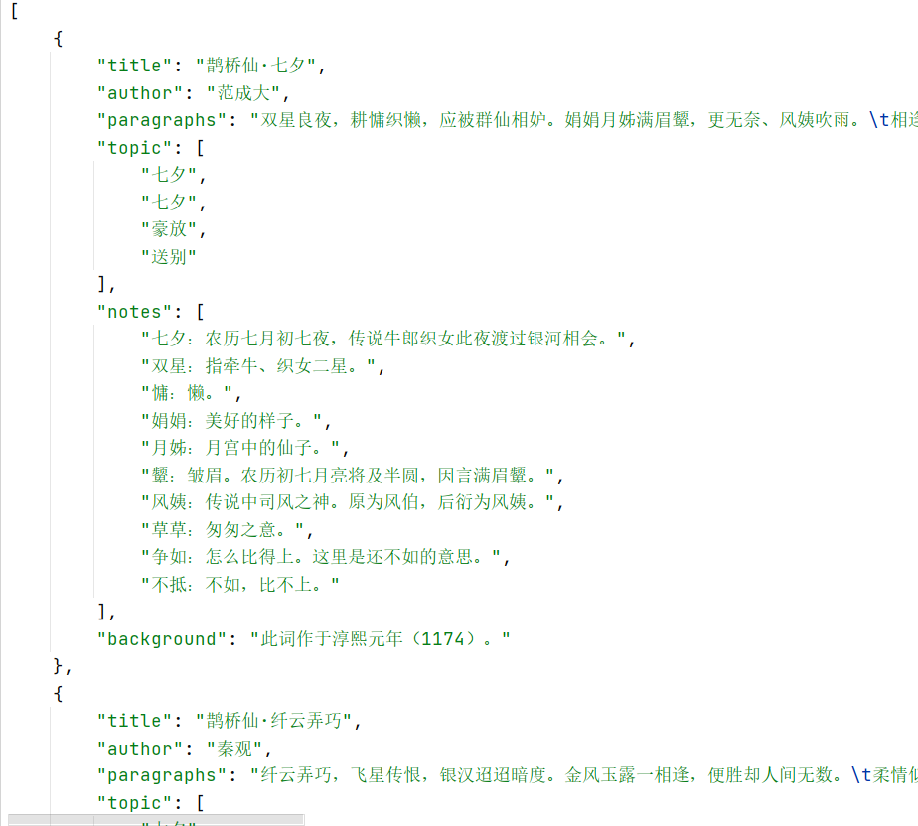
Conclusion
https://github.com/Imposingapple/scrapy_poetry
Task: rigid formats controlled text generation
SongNet: A pre-training and fine-tuning framework
Sets of symbols are tailor designed to improve the modeling performance for format, rhyme, and sentence integrity.
better results in terms of both automatic metrics and human evaluations given arbitrary cold start formats.

Slide 36






Thank you
Apple
chp33@126.com

